Slide 1
Java Performance Tuning

Slide 2
Optimization – Why?
Getting Java apps to run is one thing. But getting them to run faster and achieving SLA is another challenge.
Achieving best Performance is a tricky, and the complexity of the JVM and Garbage Collection makes it more challenging.
Lets first understand architecture of
JVM
Memory Model
Garbage Collector
and further explore how we can tune them, to achieve better performance.

Slide 3
JVM Internal Architecture
Java bytecode runs in a JRE (Java Runtime Environment). The most important element of the JRE is Java Virtual Machine (JVM), which interprets/executes Java byte code.
Understanding internal architecture of JVM helps to write better Java Code, and helps in Performance Profiling and Tuning.
VM (Java Virtual Machine) is an abstract machine, whose instruction set is byte code. It is a specification that provides runtime environment in which java bytecode can be executed.
JVMs are available for many hardware and software platforms, and JVM is Platform Dependent.
JVMs are generally developed in C/C++

Slide 4
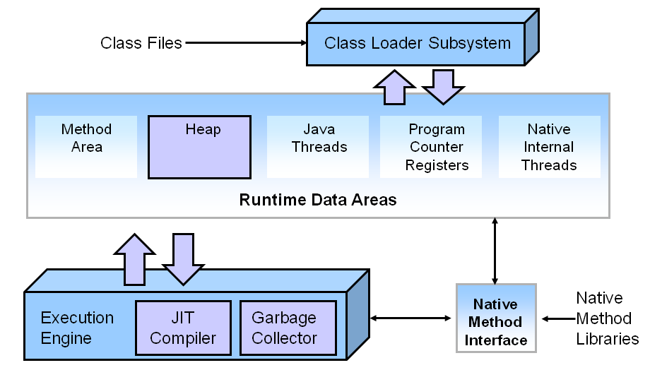
JVM Key Components

Slide 5
JVM Internal Architecture
Below are components of JVM:
Class Loader
Byte Code Verifier
Execution Engine
Garbage Collector
Security Manager

Slide 6
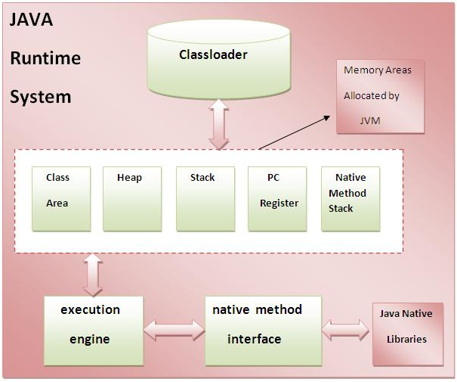
JVM Internal Architecture

Slide 7
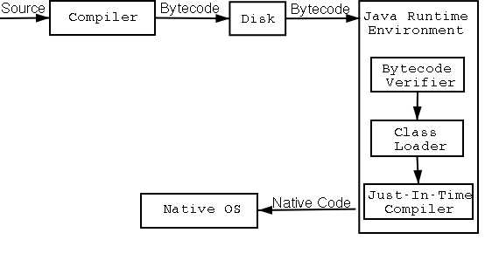
Java Code Compilation and Execution

Slide 8
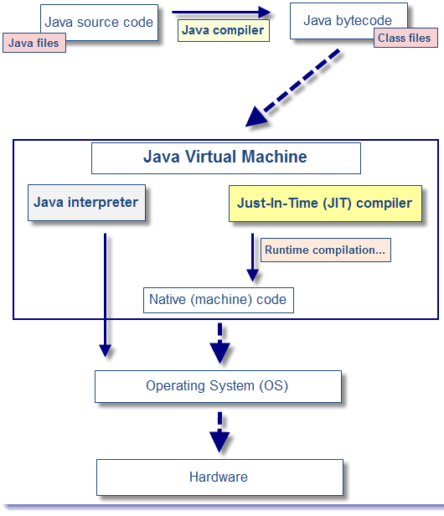
Interpreter and JIT Compiler

Slide 9
JVM Internal Components
ByteCode verifier: ByteCode verifier checks if the read bytecode, is valid, and detects any malicious operations which may corrupt data/code.
Classloader: Classloader is a subsystem of JVM that is used to load required class files(compiled byte code of each class file)
Class(Method) Area: Class(Method) Area stores per-class structures such as the runtime constant pool, field and method data, the code for methods.
Heap: It is the runtime data area in which objects are allocated.
Stack: Java Stack stores frames. It holds local variables and partial results, and plays a part in method invocation and return.

Slide 10
JVM Internal Architecture
Each thread has a private JVM stack, created at the same time as thread.
A new frame is created each time a method is invoked.
A frame is destroyed when its method returns.
Program Counter Register: PC (program counter) register. It contains the address of the Java virtual machine instruction currently being executed.
Native Method Stack: It contains all the native methods used in the application.

Slide 11
Execution Engine: Interpreter & JIT Compiler
The bytecode that is loaded using class loader is executed by the execution engine.
Then the execution engine changes the Java bytecode to the native machine language. The bytecode can be changed to the native machine language in one of two ways.
Interpreter: Reads, interprets and executes the bytecode instructions one by one. As it interprets and executes instructions one by one, it can quickly interpret one bytecode, but slowly executes the interpreted result.
JIT (Just-In-Time) compiler: The JIT compiler overcomes disadvantages of the interpreter. JIT compiler compiles the entire bytecode to change it to native code. Frequently invoked Nativecode is stored in cached, and retrieved from cache whenever required, rather than interpreting it again and again, which makes overall execution faster.
Either of above can be used, based on whether same code need to be executed again and again.

Slide 12
Security Manager
SecurityManager class allows applications to implement a security policy.
It allows an application to determine, before performing a possibly unsafe or sensitive operation, what the operation is and whether it is being attempted in a security context that allows the operation to be performed.
The application can allow or disallow the operation.

Slide 13
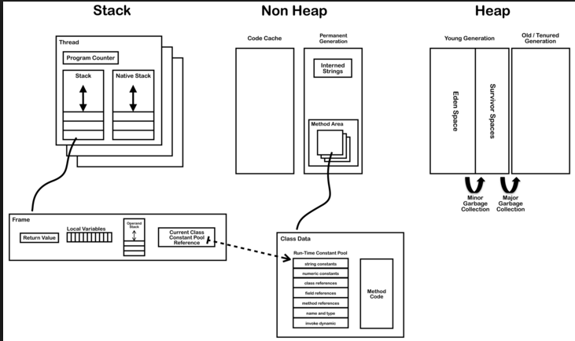
Java Program under Execution in JVM

Slide 14
Stack

Slide 15
Reasons for Performance Problems
Excessive Synchronous Logging (Use Async option in Log4j, for better performance)
Excess Memory usage
Thread Synchronization/DeadLock
Improper Tuning of JVM/Garbage Collector
Improper Design/Coding due to poor understanding of Concepts like GC.
ItemStock[] stocks = catalogSessionBean.loadAllStocks();
for (ItemStock stock : stocks)
{
if (stock.getProductId().getId()==id) { if(catalogSessionBean.updateStock(stock,-1)){ basketBean.addToBasket(id); . . . } . . . }

Slide 16
Reasons for Performance Problems
Improper Interaction with database:
Do not interact with database very frequently
Limit the number of records fetched(For eg. Using stmt.setFetchSize(100); )
Use indexing

Slide 17
How To Improve Performance
Understanding JVM Internals
Memory Model
Working of Garbage Collector
Various Garbage Collector Algorithms
Tuning Garbage Collector
Monitor Heap, GC, Lock Contention using various Tools
Tuning Memory Allocations
Tuning JIT Compiler
Understanding Lock Contention
Changing Design/code

Slide 18
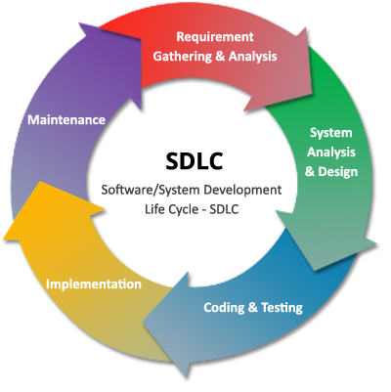
When Performance?

Slide 19
Role of Garbage Collector
As known Memory can be allocated and de allocated from Heap, when the Program is under execution.
Such Heap Memory de allocation need to be performed by Programmer in Programming Languages such as C/C++, failing which Memory Leak occurs.
However in Java we are relieved from destroying unreferenced objects, as Garbage Collector, automatically performs this.
However, this Garbage Collection causes Performance Hit. Hence Garbage Collection need to be understood, and tuned to avoid or control Performance issues.

Slide 20
Role of Garbage Collector…
Garbage Collection Tuning plays vital role especially in Long Running or memory Intensive Applications

Slide 21
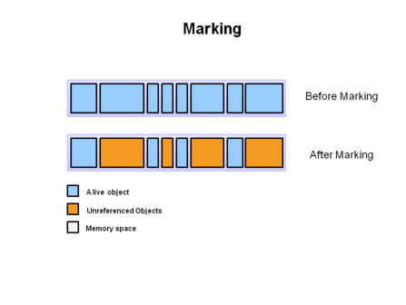
What Garbage Collection actually does?
One of the basic way of garbage collection involves three steps:
Marking: This is the first step where garbage collector identifies which objects are in use and which ones are not in use.

Slide 22
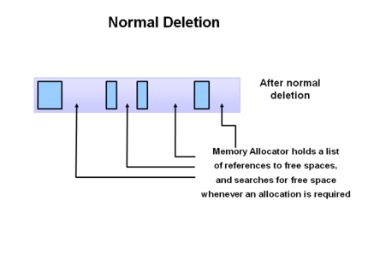
What Garbage Collection actually does?
Normal Deletion: Garbage Collector removes the unused objects and reclaim the free space to be allocated to other objects.

Slide 23
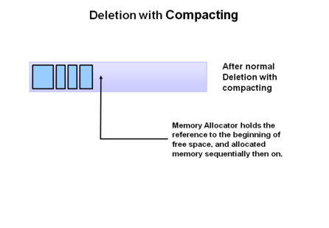
What Garbage Collection actually does?
Deletion with Compacting: For better performance, after deleting unused objects, all the survived objects can be moved to be together. This will increase the performance of allocation of memory to newer objects.

Slide 24
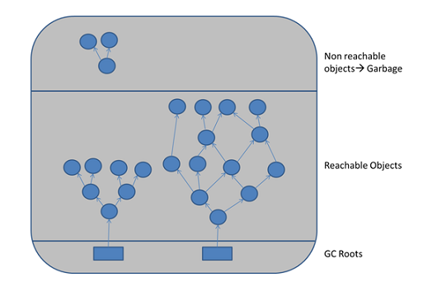
Object reachability checking
Garbage Collector checks reachability of the objects

Slide 25
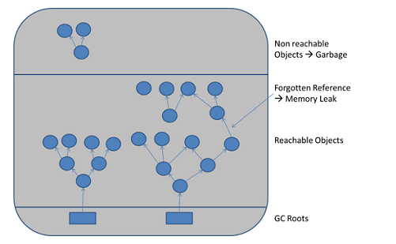
Object reachability checking
Garbage Collector checks reachability of the objects

Slide 26
GC Verbose options
The -verbose:gc option enables logging of garbage collection (GC) information. It can be combined with other HotSpot VM specific options such as -XX:+PrintGCDetails and -XX:+PrintGCTimeStamps to get further information about the GC. The information output includes the size of the generations before and after each GC, total size of the heap, the size of objects promoted, and the time taken.
The -verbose:gc option can be dynamically enabled at runtime using the management API or JVM TI.

Slide 27
GC Verbose option output
The verbose:gc logs contain valuable information about:
GC pause times
Frequency of GC
Application run times
Size of objects created and destroyed
Rate of object creation
Memory recycled at each GC
The behavior of the application can be charted and analyzed, based on these statistics
Total active data:
This is the total data alive at any instance of time.
This is critical for building a model for sizing the JVM heap.
For example, for a load of 100 transactions per second, with long term data of 50K per transaction lasting for a minimum of 40 seconds,
Minimum memory footprint of the old generation would have to be
50K*40s*100 = 200M

Slide 28
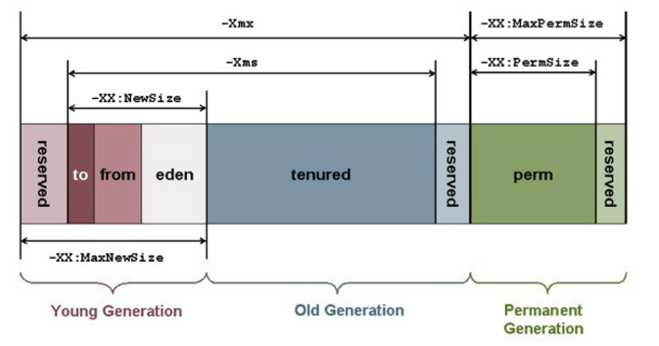
JVM – Heap Memory Model
Understanding Memory structure is very important to get insight on working of Garbage Collector.
And Tuning Garbage Collector plays important role in controlling memory and performance aspects of a Java Application.
Java(JVM) Memory Model

Slide 29
Heap Memory Model – In Depth
At broad level, JVM Heap memory is divided into two parts
Young Generation
Old Generation.
Young Generation:
Young generation is the place where all the new objects are created.
When young generation is filled, garbage collection is performed.
This garbage collection is called Minor GC.
Young Generation is further divided into three parts – Eden Memory and two Survivor Memory(S0 and S1) spaces.

Slide 30
Young Generation Memory
Important Points about Young Generation Spaces:
Most of the newly created objects are located in the Eden memory space.
When Eden space is filled with objects, Minor GC is performed and all the survivor objects are moved to one of the survivor spaces.
Minor GC also checks the survivor objects and move them to the other survivor space.
Objects that are survived after many cycles of GC, are moved to the Old generation memory space. Usually it’s done by setting a threshold for the age of the young generation objects before they become eligible to promote to Old generation.

Slide 31
Old Generation Memory
Old Generation memory contains the objects that are long lived and survived after many rounds of Minor GC.
Usually garbage collection is performed in Old Generation memory when it’s full.
Old Generation Garbage Collection is called Major GC and generally takes longer time.

Slide 32
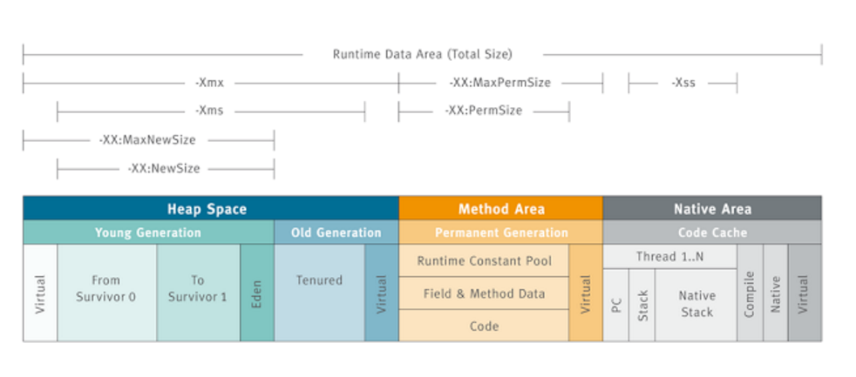
Java Process Memory Snapshot

Slide 33
Garbage Collector Stops Java Apps
All the Garbage Collections are “Stop The World” (referred as STW) events because all application threads are stopped until the operation completes.
Since Young generation keeps short-lived objects, Minor GC is very fast and the application doesn’t get much affected by this.
However Major GC takes longer time because it checks all the live objects.
Major GC should be minimized because it will make your application unresponsive for the garbage collection duration.
For a responsive application and with lot of Major Garbage Collection happening, you will notice timeout errors, and it may effect overall SLA.

Slide 34
Garbage Collector Stops Java Apps
The duration taken by garbage collector depends on the strategy used for garbage collection.
Hence garbage collector tuning is required to avoid timeouts in the highly responsive applications.
How Garbage Collector Helps us? Does Garbage Collection hits performance of Java Application?
In which Java Applications garbage Collection plays important Role? In long running Applications or Applications using huge heap memory.
So, for the Java App to be more responsive, this stop/pause need to be as brief as possible.

Slide 35
jcmd

Slide 36
Java Class Loader
when we try to use a Class, Java ClassLoader loads that class into memory.
There are three types of built-in ClassLoader in Java:
Bootstrap Class Loader – It loads JDK internal classes, typically loads rt.jar and other core classes for example java.lang.* package classes
Extensions Class Loader – It loads classes from the JDK extensions directory, usually $JAVA_HOME/lib/ext directory.
System Class Loader – It loads classes from the current classpath that can be set while invoking a program using -cp or -classpath command line options.
Java ClassLoader are hierarchical and whenever a request is raised to load a class, it delegates it to its parent and in this way uniqueness is maintained in the runtime environment. If the parent class loader doesn’t find the class then the class loader itself tries to load the class.

Slide 37
Java Class Loader
Why we need to write our own ClassLoader?
How classLoader can cause performance issues?

Slide 38
Different References
There are four kind of reference in Java :
Strong reference
Weak Reference
Soft Reference
Phantom Reference
Strong Reference is most simple as we use it in our day to day programming life e.g. in the code, String s = "abc" , reference variables has strong reference to String object "abc".
Any object which has Strong reference attached to it is not eligible for garbage collection. Obviously these are objects which is needed by Java program.
Weak Reference are represented using java.lang.ref.WeakReference class and you can create Weak Reference by using following code :

Slide 39
Different References
Counter counter = new Counter(); // strong reference – line
WeakReference<Counter> weakCounter = new WeakReference<Counter>(counter);
counter = null; // now Counter object is eligible for g collection
As soon as you make strong reference counter = null, counter object created on line 1 becomes eligible for garbage collection; because it doesn't have any more Strong reference and Weak reference by reference variable weakCounter can not prevent Counter object from being garbage collected.
On the other hand, had this been Soft Reference, Counter object is not garbage collected until JVM absolutely needs memory.
Soft reference in Java is represented using java.lang.ref.SoftReference class

Slide 40
Different References
. You can use following code to create a SoftReference in Java
Phantom reference is third kind of reference type available in java.lang.ref package. Phantom reference is represented by java.lang.ref.PhantomReference class. Object which only has Phantom reference pointing them can be collected whenever Garbage Collector likes it.
Similar toWeakReference and SoftReference you can create PhantomReference by using following code :
DigitalCounter digit = new DigitalCounter();
// digit reference variable has strong reference PhantomReference<DigitalCounter> phantom = new PhantomReference<DigitalCounter>(digit);
// phantom reference to object created at line 3
digit = null;

Slide 41
Phantom Reference
As soon as you remove Strong reference, DigitalCounter object created at line 3 can be garbage collected at any time as it only has one more PhantomReference pointing towards it, which can not prevent it from GC'd.
Apart from knowing about WeakReference, SoftReference, PhantomReference and WeakHashMap there is one more class called ReferenceQueue which is worth knowing.
You can supply a ReferenceQueue instance while creating any WeakReference, SoftReference orPhantomReference.

Slide 42
Different References - Advantages
Java has a SoftReference that you can use to keep a weak handle on some expensive object that you have.
The JVM knows that it can dereference any object referenced by a SoftReference if it needs to. For example:
MagicBean hugeExpensiveThing = ...; // create some huge memory hog
SoftReference expensiveThingReference = new SoftReference(hugeExpensiveThing);
And to access your MagicBean
MagicBean myExpensiveThing = (MagicBean) expensiveThingReference.get();
Normally you may well create lots of MagicBean's and consume a load of memory each time until there's none left
and the JVM bails, but by using this technique we are telling the JVM that it can take back the memory used by
anything referenced through a SoftReference if it needs the memory back. This is a really neat trick to help you
keep your application running rather than just falling over unexpectedly. To use this method effectively though
you must be prepared for the expensiveThingReference.get() method to return null which will happen if the JVM's
claimed back the memory.

Slide 43
Memory Model – Permanent Generation
Permanent Generation or “Perm Gen” contains the application metadata required by the JVM to describe the classes and methods used in the application.
Perm Gen is not part of Java Heap memory.
Perm Gen is populated by JVM at runtime based on the classes used by the application.
Perm Gen also contains Java SE library classes and methods.
Perm Gen objects are garbage collected in a full garbage collection.

Slide 44
String constant pool in JDK1.6
String pooling is a process of replacing several String objects with equal value but different identity with a single shared String object, for Strings created with ne you can use s1.intern() method which is provided by JDK.
All interned strings were stored in the PermGen – the fixed size part of heap mainly used for storing loaded classes and string pool.
Biggest issue with such string pool in Java 6 was its location – the PermGen. PermGen has a fixed size and can not be expanded at runtime. You can set it using -XX:MaxPermSize=Noption. You can increase its size, but its size will still be fixed.

Slide 45
String constant pool in JDK1.7
Important change to the string pooling logic in Java 7 – the string pool was relocated to the heap. It means that you are no longer limited by a separate fixed size memory area. All strings are now located in the heap, as most of other ordinary objects, which allows you to manage only the heap size while tuning your application. Technically, this alone could be a sufficient reason to reconsider using str.intern() in your Java 7 programs.
Being eligible for garbage collection and residing in the heap, a JVM string pool seems to be a right place for all your strings. In theory it is true – non-used strings will be garbage collected from the pool, used strings will allow you to save memory in case then you get an equal string from the input

Slide 46
Reasons for OutOfMemoryError
Detail | Reason |  | How to Solve it
Java heap space | object allocation failed due to lack of Java heap |  | Increase heap size and analyze heapdump of your JVM, even excessive usage of finalize() can cause this
GC Overhead limit exceeded | 98% of its time doing garbage collection and recovering less than 2% of heap |  | Increase the heap size and turn off this with JVM flag -XX:-UseGCOverheadLimit
Requested array size exceeds VM limit | allocating an array that is larger than the heap size |  | Heap size too small, adjust it. Change ur app code to decrease array size
Metaspace

Slide 47
Reasons for OutOfMemoryError
Detail | Reason |  | How to Solve it
request size bytes for reason. Out of swap space? | allocation from the native heap failed and the native heap might be close to exhaustion.
Compressed class space | Mismatch in 64 and 32 bit
reason stack_trace_with_native_method | stack trace is printed in which the top frame is a native method, then this is an indication that a native method has encountered an allocation failure |  | use native utilities of the OS to further diagnose the issue

Slide 48
OutOfMemoryError: PermGen Space
The OutOfMemoryError: PermGen Space error occurs when the permanent generation heap is full. Although this error can occur in normal circumstances, usually, this error is caused by a memory leak.
In short, such a memory leak means that a classloader and its classes cannot be garbage collected after they have been undeployed/discarded.
To give an example on how this can happen, let’s say we have a Payment class, which is part of a jar in a web application that is deployed on some webserver. In the lib folder of the web server, there is some logging framework present, which has a Log class with the method register(Class clazz) with which classes can be registered for logging.
Let’s say that the Payment class gets registered by this method and the Log class starts keeping a reference to the clazz object. When the Payment class gets undeployed, it is still registered with the Log class. The Log class will still have a reference to it and hence, it will never be garbage collected. Moreover, since the Payment Class has a reference to its ClassLoader in turn, the ClassLoader itself will never be garbage collected either, and so will none of the classes it loaded.
NOTE: In JDK 1.8 PermGen replaced with MetaSpace

Slide 49
OutOfMemoryError: PermGen Space
How to avoid OutOfMemoryError: PermGen Space error ?
1. Increasing the maximum size of the permgen heap
2. Be careful, when using static fields on classes.
Make sure you do not write classes that have static variables keeping references to class definitions and the like.
Using JDK dynamic proxies instead of cglib proxies
Some third party frameworks, such as cglib(although it might be better for newer versions of the library?), appear to be permgen monsters.
So using jdk dynamic proxies instead of cglib might be a good idea when getting the error.
Also, newer versions of Hibernate appear to not use cglib as a bytecode provider anymore, so upgrading your version of Hibernate, might drastically lower your chances on getting the error.

Slide 50
Memory Model – Permanent Generation
Java Memory Model – Method Area
Method Area is part of space in the Perm Gen and used to store class structure (runtime constants and static variables) and code for methods and constructors.
Java Memory Model – Memory Pool
Memory Pools are created by JVM memory managers to create a pool of immutable objects, if implementation supports it. String Pool is a good example of this kind of memory pool. Memory Pool can belong to Heap or Perm Gen.
Java Memory Model – Runtime Constant Pool
Runtime constant pool is per-class runtime representation of constant pool in a class. It contains class runtime constants and static methods. Runtime constant pool is the part of method area.
Java Memory Model – Java Stack Memory
Java Stack memory is used for execution of a thread. They contain method specific values that are short-lived and references to other objects in the heap that are getting referred from the method.

Slide 51
What Garbage Collection actually does?
Identifying and remove the unused objects from the memory and free space to be allocated to objects created in the future processing.
One of the best feature of java programming language is the automatic garbage collection, in C/C++ such Heap memory need to be manually deleted or freed, and when such freeing is not done or improperly done, results in memory Leak.
Garbage Collector is the program running in the background that looks into all the objects in the memory and find out objects that are not referenced by any part of the program.
All unreferenced objects are deleted and space is reclaimed for allocation to other objects.

Slide 52
List of Tools to Monitor and Tune performance
Command Line based Tools
Jstat
Jstatd
Jps – to get all java process ids
Jconsole
Java
Jmap – to get Heap dump
Jstack – to get Thread dump
Jhat – Usage jhat dump.hprof
GUI Based Tools
VisualVM
VisualGC
Eclipse MAT

Slide 53
How to Measure Performance?
Performance can be measured using below units
Latency/Pause Time – For User Interaction Applications
Throughput – For Background Applications like Batches
Latency/Pause Time:
This is how long the application pauses/appears unresponsive because of garbage collection.
Better to consider both maximum pause time, and various statistics like average and standard deviation.
This time need to be minimum, for the Application, to be responsive.

Slide 54
How to Measure Performance?
Throughput:
This is the percentage of total time not spent in garbage collection considered over long periods of time.
If application spends 10% of its time in garbage collection the throughput is 90%.
For application, to perform as many calculations as possible, need to tune the garbage collection to maximize throughput.
FootPrint: How memory is used by the JVM when running Application.

Slide 55
Garbage Collector Algorithms
Serial Collector:
Serial collector is the simplest one, and the one not being used, as it’s mainly designed and works best for single-threaded environments (e.g. 32 bit or Windows) and for small heaps( <100MB).
This collector freezes all application threads whenever it’s working, which disqualifies it for all intents and purposes from being used in a server environment.
It can be enabled by using -XX:+UseSerialGC JVM argument.
Parallel/Through Put Collector: [Bestfit for Batch kind of Applications]
Parallel collector is the JVM’s default collector. Much like its name, its biggest advantage is that is uses multiple threads to scan through and compact the heap.
The downside to the parallel collector is that it will stop application threads when performing either a minor or full GC collection.
The parallel collector is best suited for apps that can tolerate application pauses and are trying to optimize for lower CPU overhead caused by the collector.
It can be enabled using -XX:+UseParallelGC

Slide 56
Garbage Collector Algorithms
CMS Collector: CMS collector (“ concurrent-mark-sweep”) algorithm uses multiple threads (“concurrent”) to scan through the heap (“mark”) for unused objects that can be recycled (“sweep”).
This algorithm will enter “stop the world” (STW) mode in two cases: when initializing the initial marking of roots (objects in the old generation that are reachable from thread entry points or static variables) and when the application has changed the state of the heap while the algorithm was running concurrently, forcing it to go back and do some final touches to make sure it has the right objects marked.
Heap should be less than 4Gb in size. -XX:+UseParNewGC

Slide 57
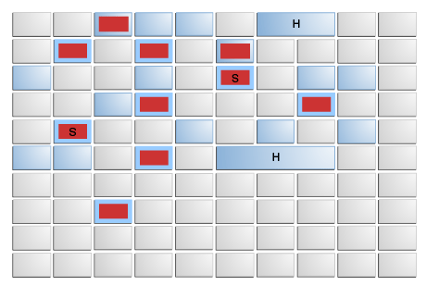
Garbage First Heap Regions
Eden regions (red) and survivor regions (red with "S").
Old regions (light blue) make up the old generation.
Old generation regions may be humongous (light blue with "H") for objects that span multiple regions.
-XX:MaxGCPauseMillis – Target GC Pause Time

Slide 58
Garbage Collector Algorithms
Garbage First Collector:
Garbage first collector (G1) introduced in JDK 7 update 4 was designed to better support heaps larger than 4GB.
The G1 collector utilizes multiple background threads to scan through the heap that it divides into multiple regions,
Each region may span from 1MB to 32MB (depending on the size of your heap).
G1 collector is geared towards scanning those regions that contain the most garbage objects first, giving it its name (Garbage first).
This collector is turned on using the –XX:+UseG1GC flag.

Slide 59
Garbage Collector Algorithms
Java 8 and the G1 Collector:
This optimization was added with Java 8 update 20 for is the G1 Collector
String deduplication.
Since strings (and their internal char[] arrays) takes much of our heap, a new optimization has been made that enables the G1 collector to identify strings which are duplicated more than once across your heap and correct them to point into the same internal char[] array.
This avoids multiple copies of the same string from residing inefficiently within the heap.
To enable use the option -XX:+UseStringDeduplication

Slide 60
Which gc algorithm to use?
GC Algorithm Name | When to use?
Serial Collector | Single Threaded/Single Processor, desktop based Apps, with minimal data(Heap <100MB). Apps are fine with Pauses
Parallel Collector | This Collector is enabled by default, and results in high Throughput
Concurrent Mark Sweep (CMS) Collector | Applications that prefer shorter garbage collection pauses
Garbage-First Garbage Collector | server-style collector is for multiprocessor machines with large memories. It meets garbage collection pause time goals with high probability while achieving high throughput. During later JDK releases G1 may replace CMS

Slide 61
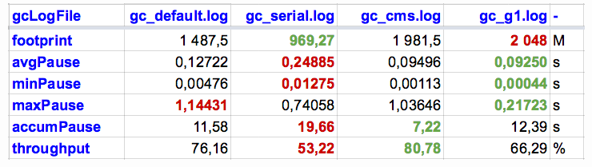
Comparison of GC algorithms

Slide 62
Hotspot JVM Heap Size Options
-XX:NewSize | New generation heap size
-XX:MaxNewSize | maximum size of the New Generation heap size.
-XX:SurvivorRatio | ratio of the Eden/survivor space size. Set to 8 and monitor Garbage Collection
-Xms | intial heap size
-Xmx | maximum size of the heap
Note: set minimum heap size (-Xms) equal to the maximum heap size
(-Xmx) to minimize garbage collections.

Slide 63
Purpose of jps
JPS Java Virtual Machine Process Status Tool, The jps tool lists the instrumented HotSpot Java Virtual Machines (JVMs) on the target system.
It is also possible to get Java Process running on remote machine.
OPTIONS
The jps command supports a number of options that modify the output of the command.
-q Suppress the output of the class name, JAR file name, and arguments passed to the main method, producing only a list of local VM identifiers.
-m Output the arguments passed to the main method. The output may be null for embedded JVMs.
-l Output the full package name for the application's main class.
-vOutput the arguments passed to the JVM.
-VOutput the arguments passed to the JVM through the flags file (the .hotspotrc file or the file specified by the -XX:Flags=<filename> argument).-
For example, -J-Xms48m sets the startup memory to 48 megabytes. It is a common convention for -J to pass options to the underlying VM executing applications written in Java. For Gigabytes m can be replaced with g
NOTE:
Even caps can be used i..e suffix G or M are valid.
MB or GB suffix is not valid

Slide 64
How to Check memory Allocation size?
Jstat Tool provided with JDK, is used to find memory allocations for various Heap Memory components or parts.
How to use jstat?
jstat –gc 2367 1000 10
2367 is process id and 1000 prints memory allocation details every 1 second
10 prints the output 10 times
jstat -gcold 2924 1000 10
jstat -gcoldcapacity 2924 1000 10
jstat -gcnew 2924 1000 10
jstat -gcnewcapacity 2924 1000 10

Slide 65
How to read jstat output?
S0C and S1C: This column shows the current size of the Survivor0 and Survivor1 areas in KB.
S0U and S1U: This column shows the current usage of the Survivor0 and Survivor1 areas in KB.
EC and EU: These columns show the current size and usage of Eden space in KB. Note that EU size is increasing and as soon as it crosses the EC, Minor GC is called and EU size is decreased.
OC and OU: These columns show the current size and current usage of Old generation in KB.
PC and PU: These columns show the current size and current usage of Perm Gen in KB.

Slide 66
How to read jstat output?
YGC and YGCT: YGC column displays the number of GC event occurred in young generation. YGCT column displays the accumulated time for GC operations for Young generation. Notice that both of them are increased in the same row where EU value is dropped because of minor GC.
FGC and FGCT: FGC column displays the number of Full GC event occurred. FGCT column displays the accumulated time for Full GC operations. Notice that Full GC time is too high when compared to young generation GC timings.
GCT: This column displays the total accumulated time for GC operations. Notice that it’s sum of YGCT and FGCT column values.

Slide 67
How to adjust stack size?
Below option can be used to adjust stack size
-Xss
java -Xss4m Test
Question: When multiple threads exist and main thread throws StackOverflowError, does other threads continue to run?
HOW TO FIND CURRENT DEFAULT JVM OPTIONS?
java -XX:+PrintFlagsFinal | findstr /I "Xmm“
java -XX:+PrintCommandLineFlags -version

Slide 68
How to use JMAP command
Usage
jmap -dump:live,file=<file-path> <pid>
where pid: is the Java Process Id, whose heap dump should be captured
file-path: is the file path where heap dump will be written in to.
Example:
jmap -dump:live,file=D:/AddressBook-heapdump.bin 37320

Slide 69
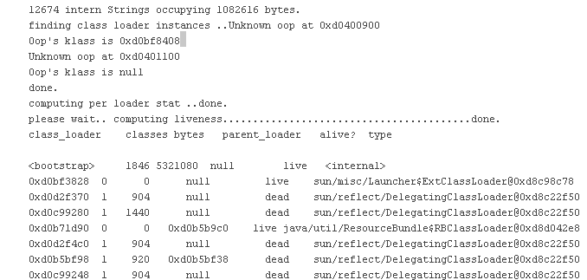
JMAP with permgen
Permanent Generation Statistics of Java Heap for a Process
$ jmap -permstat 29620 //29620 is process id

Slide 70
Do we need to set references to null?
No, generally do not set local variables to null to hasten their collection by the GC: the compiler is smart enough to figure it out without our help; the null assignments will only make your code look dirty. Except in some situations like below
if longer scope where a memory-intensive object ceased to be used partway through the scope. For example:
{
HugeObject obj = ...
doSomethingWith(obj);
obj = null; <-- explicitly set to null
doSomethingElse();
}
The obj is still in scope, then without the explicit nulling of the reference, it does not become garbage collectable until after the doSomethingElse() method completes. And this is the advice that probably no longer holds on modern JVMs:
For Non-locals, if you have a member variable that might stay around for longer than necessary, it is a good idea to set it to null and prevent lingerer memory leaks.

Slide 71
VisualVM UI Tool
This is UI Tool to Monitor Heap usage, GC, Threads, etc… of any running Java Application.
How to get VisualVM Tool?
Download and install it from
https://visualvm.github.io/download.html

Slide 72
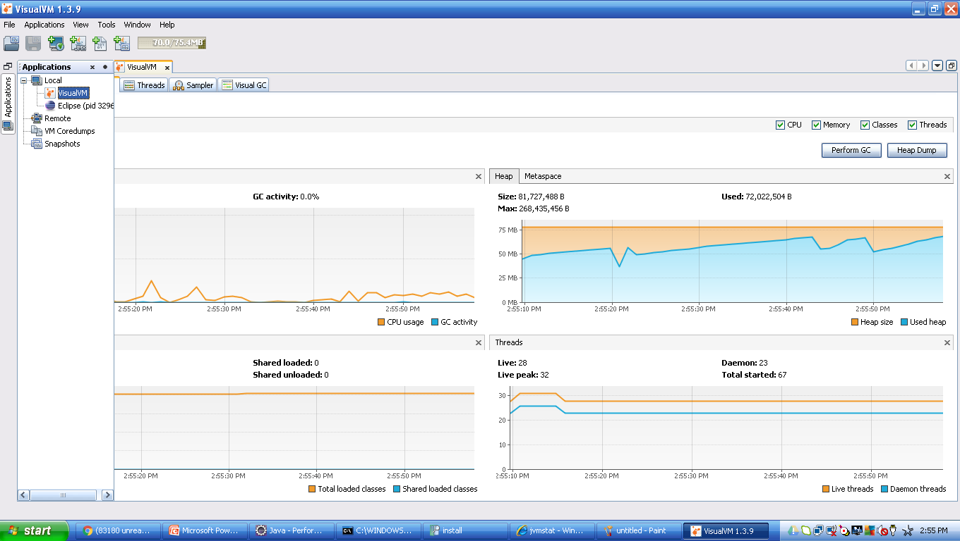
VisualVM UI Tool

Slide 73
VisualGC 2.x UI Tool
VisualGC Tool shows Eden, Survival, PermGen Memory slots, and their current usage details.
This tool is available as Plugin to VisualVM. After installing VisualVM Tool, follow below steps
Select Tools
Select Plugins
Then select VisualGC, and install

Slide 74
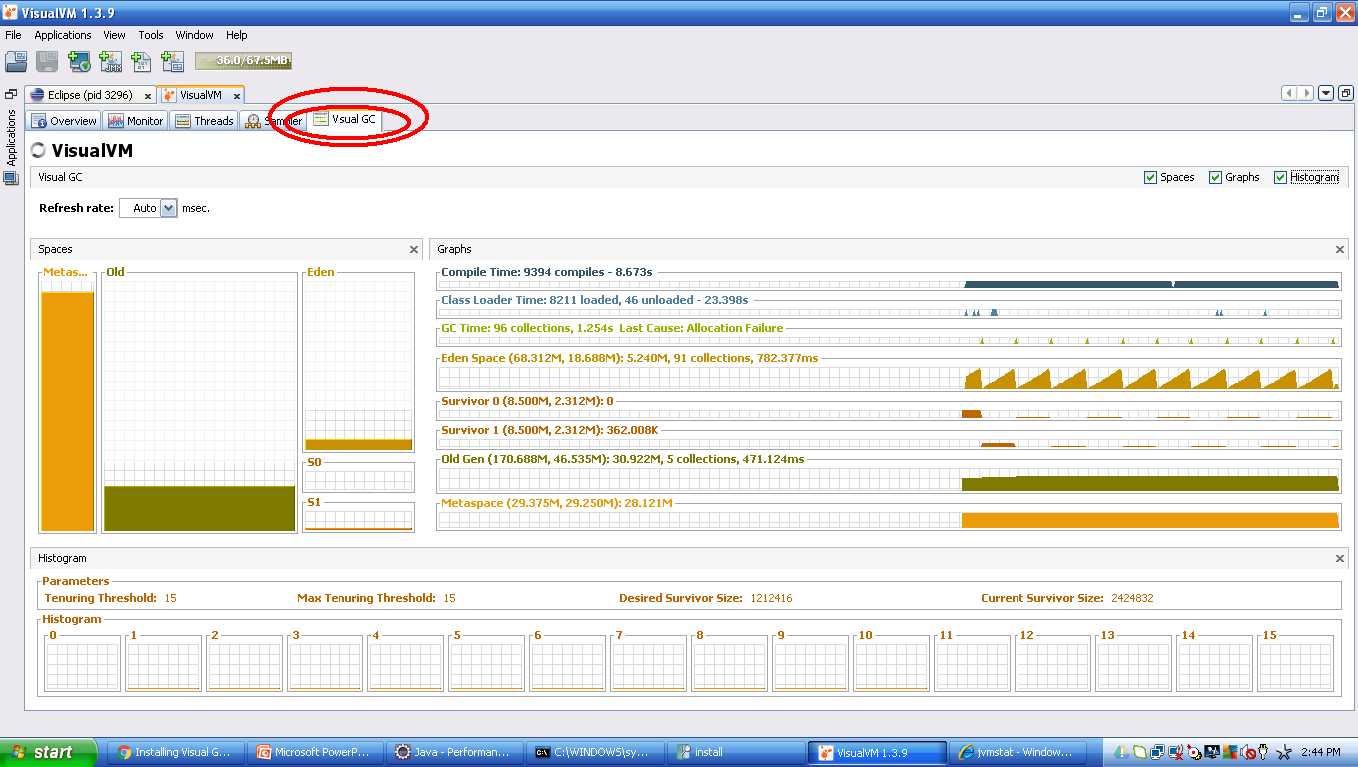
VisualGC 2.x UI Tool

Slide 75
Jconsole Tool
Jconsole Tool provided with JDK, can be used to dump Heap.
This Tool can be launched by typing jconsole in command line
Below are steps to generate HeapDump
On the MBeans tab, in the com.sun.management/HotSpotDiagnostics object, select the Operationsection.
In dumpHeap parameters, enter the following information:p0: [heap-output-path] p1: true - do a garbage collection before dump heap
For example:p0: c:/abc.dmp p1: true
Click the dumpHeap button.

Slide 76
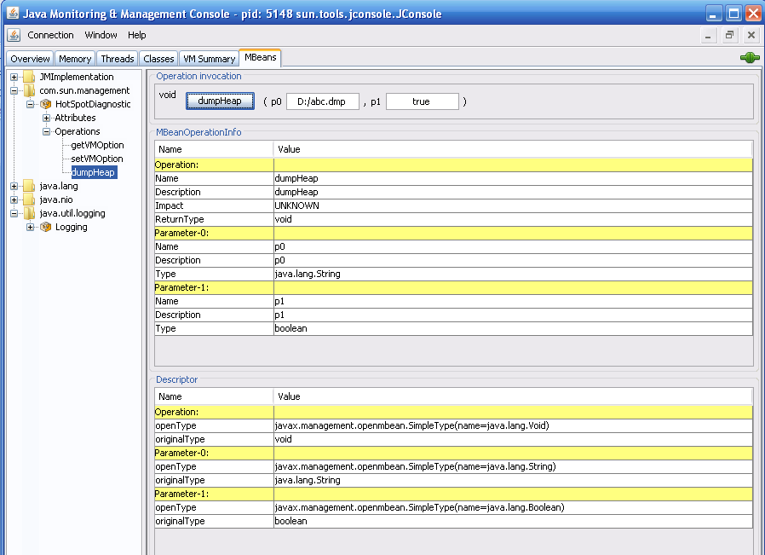
Jconsole Tool Snapshot

Slide 77
Eclipse MAT Tool – Memory Analyzer Tool
Eclipse MAT Tool is used to process and view HeapDump. It even shows minute details like number of instances of an object, etc…
How to install MAT on Eclipse
Eclipse —> Help Menu —> Install New Software —> Add
Enter below information http://download.eclipse.org/mat/1.5/update-site/ and follow onscreen instructions to complete installation of MAT Plugin to you Eclipse IDE.

Slide 78
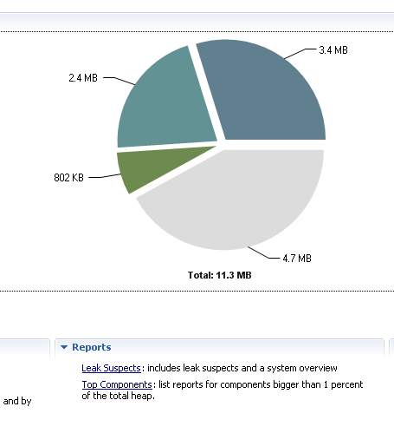
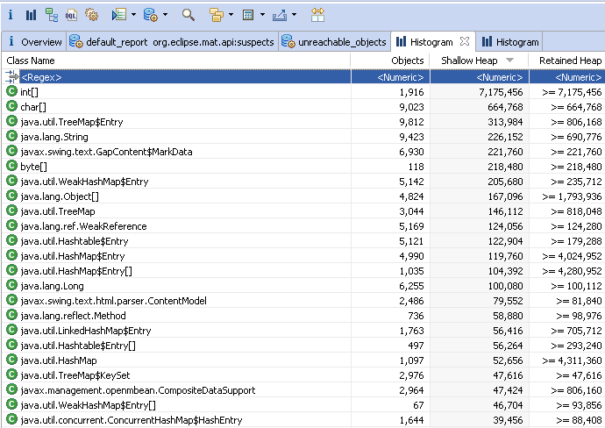
Eclipse MAT Tool Snapshots
Searchable Text

Slide 79
Eclipse MAT Tool – terminology
Outgoing References Using the following OQL statement, we have identified total
SELECT * FROM java.lang.String WHERE toString().startsWith("http://xmlns.oracle.com/apps/fnd/applcore/log/service/types")After expanding the first entry, it shows two outgoing references: a reference to the Class instance for the String object
a reference to an array of char values
Outgoing References show the actual contents of the instances, helping to find out their purpose. In our String instance, it holds two references. The memory overhead of this String instance is shown in two values:
Shallow Heap
Retained Heap
Incoming References To get incoming references of the first entry, choose List Objects with Incoming References from the context menu.

Slide 80
Incoming & Outgoing reference MAT Tool
Class A{
}
Class B
{
A obj;
}
Class C
{
B bobj;
}
If we take class B, then A is out going reference, and C is incoming reference

Slide 81
Eclipse MAT Tool – terminology
Dominator Tree: List the biggest objects and what they keep alive.
Shallow size
The shallow size of an object is amount of memory used to store the object itself. The referenced objects are not taken into account.
Retained size
The retained size of an object is the amount of memory that can be freed when the object is collected by the garbage collector.
Root
X
Y
Here object X is Dominator of Y

Slide 82
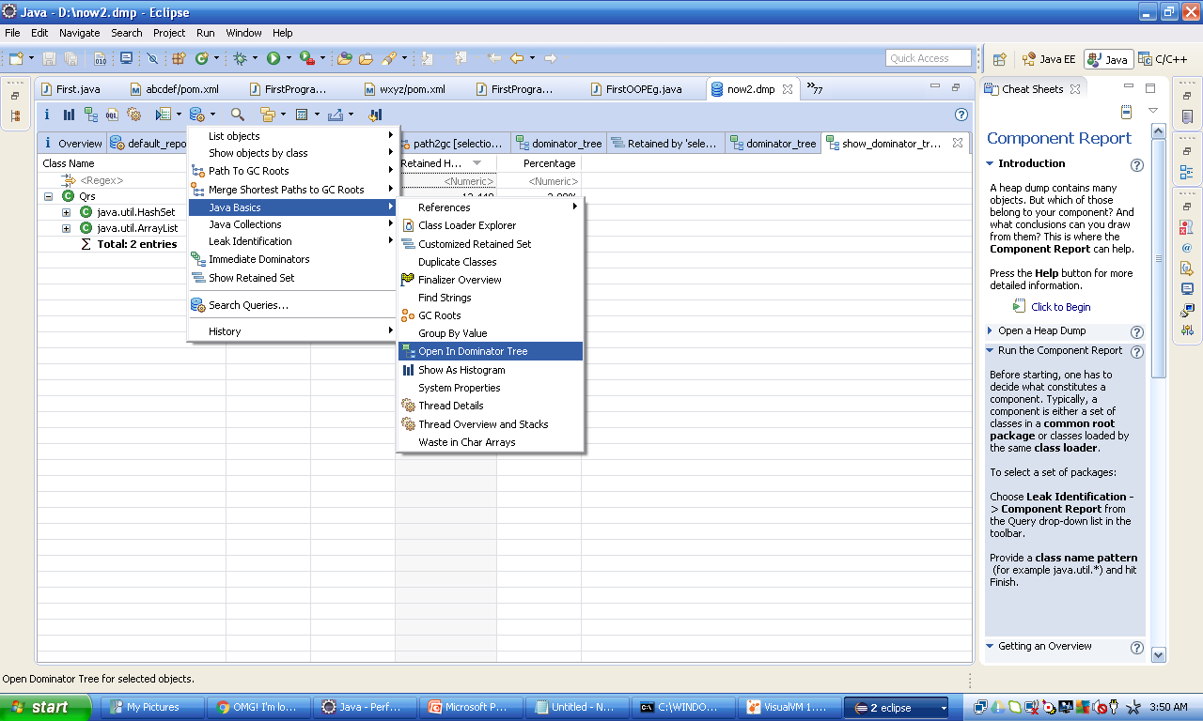
MAT Tool DOMINATOR TREE – view details of a class

Slide 83
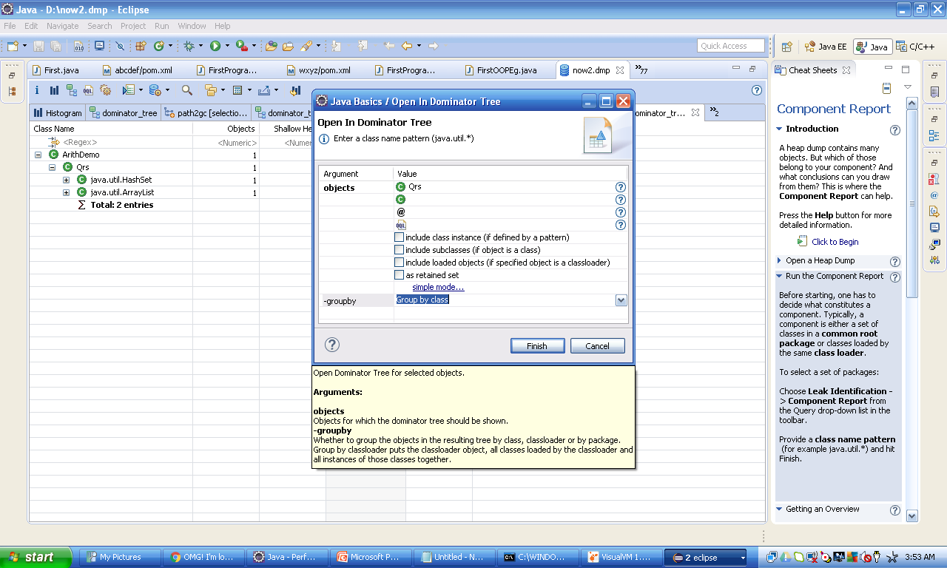
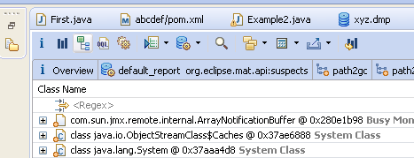
MAT Tool DOMINATOR TREE
Display Full Dominator Tree
Generate Reports(in html, pdf, etc…)
Shows Thread’s name, stack, retained heaps

Slide 84
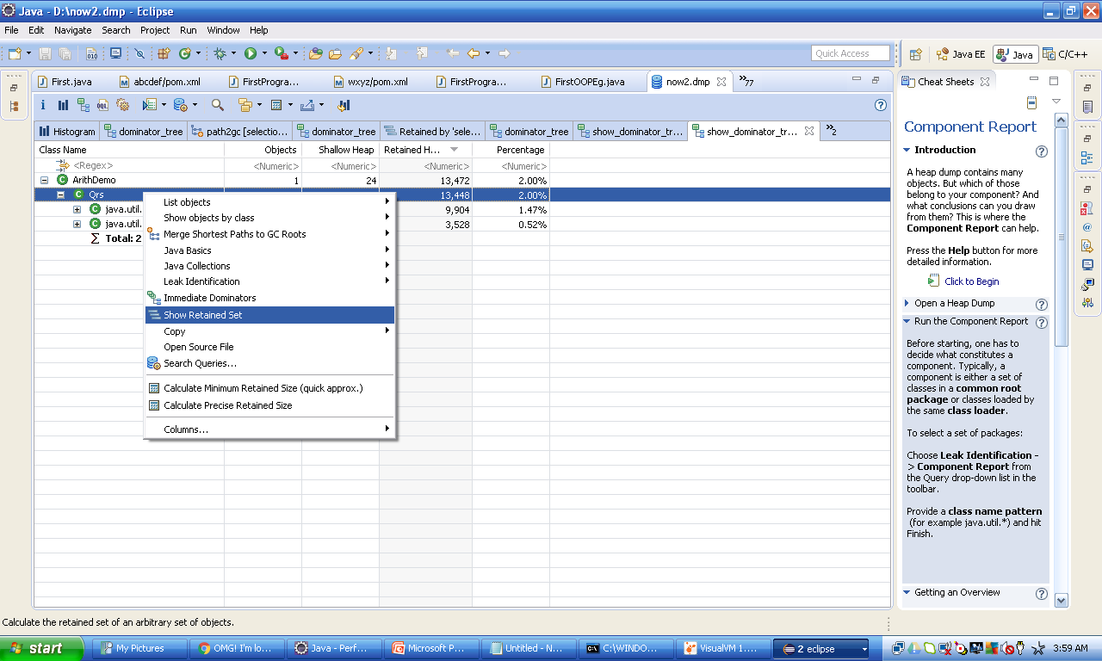
MAT Tool VIEW RETAINED SET

Slide 85
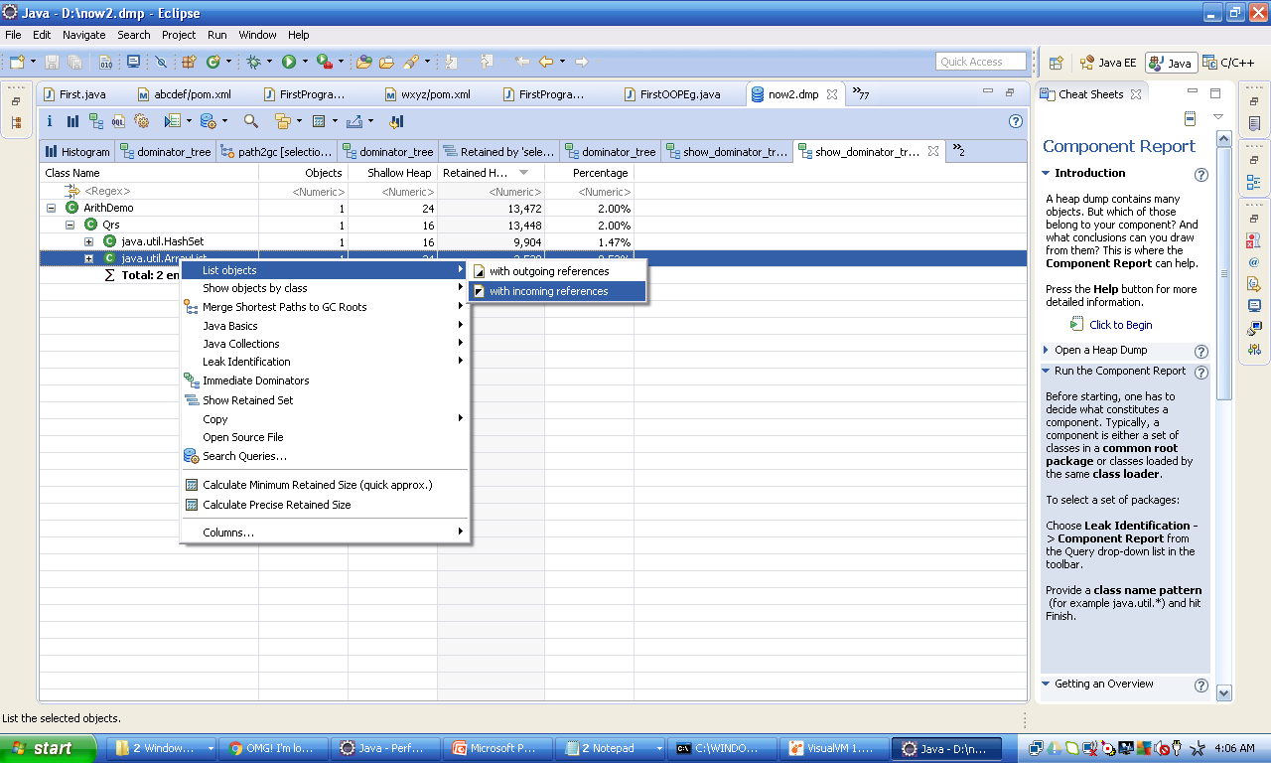
MAT Tool SHOW LARGEST OBJECT OF A TYPE

Slide 86
MAT Tool
Its possible to import the reports in various formats
MAT Supports OQL(Object Query Language): This can be used to query any information from HeapDump.
OQL is like SQL, here classes as tables, objects as rows, and fields as columns
For example: select * from java.lang.String where toString().startsWith(“abc") to query String objects with a certain prefix (i.e., “abc") and calculate the total size of retained heap associated with the interested objects.
NOTE: Blindly do not doubt code which has thrown OutOfMemory Exception, the root cause may be some other portion of your code, which may consume huge Heap memory.

Slide 87
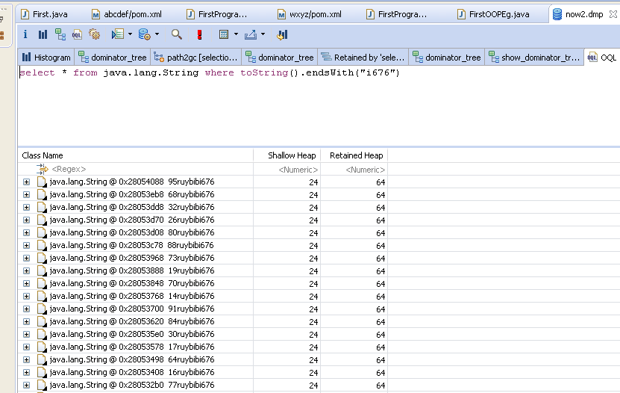
MAT Tool - OQL
OQL to display all classes in a package
SELECT * from "com.p1.*"

Slide 88
MAT Tool – immediate dominators
An Object A is said to dominate an Object B if every path from the Root to B must pass through A
Right click and select “Immediate Dominators”

Slide 89
OQL – Object Query Language
SELECT toString(s), s.count, s.value FROM java.lang.String sThe resulting table knows about the underlying object. So you can use the context menu to open further views on the object at hand. Use the @ symbol to access Java attributes and methods of the objects. There are also a number of built-in functions available to extract common information:
SELECT toString(s), s.@usedHeapSize, s.@retainedHeapSize FROM java.lang.String sThe section on Property Accessors contains details on the commonly available attributes.
Provide column names
Use the AS keyword to name the columns:
SELECT toString(s) AS Value, s.@usedHeapSize AS "Shallow Size", s.@retainedHeapSize AS "Retained Size" FROM java.lang.String sUse the AS RETAINED SET keyword to get the set of objects retained by your selection:
SELECT AS RETAINED SET * FROM java.lang.StringFlatten select items into an object list
Use the OBJECTS to interpret the items in the SELECT clause as objects:
SELECT OBJECTS dominators(s) FROM java.lang.String sThe function dominators() returns an array of objects. Therefore the query returns a list of object lists, i.e. arrays. By using the keyword OBJECTS , we force the OQL to reduce this into a single list of objects.
Select unique objects
Use the DISTINCT keyword to only select unique objects:
SELECT DISTINCT * FROM OBJECTS 0,1,1,2Use the DISTINCT OBJECTS keyword to only select unique objects from the result of the selected clause:
SELECT DISTINCT OBJECTS classof(s) FROM java.lang.String sThe function classof returns the class object.

Slide 90
OQL – Object Query Language
FROM Clause
Specify the class
The FROM clause defines the classes on which to operate. Specify the class by one of the following means:
by class name:
SELECT * FROM java.lang.String
by a regular expression matching the class name:
SELECT * FROM "java\.lang\..*“
by the object address of the class:
SELECT * FROM 0x2b7468c8
by the object addresses of more than one class:SELECT * FROM 0x2b7468c8,0x2b74aee0by the object id of the class:SELECT * FROM 20815by the object ids of more than one class:SELECT * FROM 20815,20975by a sub select:SELECT * FROM ( SELECT * FROM java.lang.Class c WHERE c implements org.eclipse.mat.snapshot.model.IClass )The statement returns all objects in the heap. The implements check is necessary, as the heap dump can contain java.lang.Class instances caused by proxy classes or classes representing primitive types such as int.class or Integer.TYPE. The following query has the same effect, which calls a method directly on the ISnapshot object:
SELECT * FROM ${snapshot}.getClasses()

Slide 91
OQL – Object Query Language
Include sub classes
Use the INSTANCEOF keyword to include objects of sub-classes into the query:
SELECT * FROM INSTANCEOF java.lang.ref.Reference
The resulting table contains, amongst others, WeakReference and SoftReference objects because both classes extend from java.lang.ref.Reference .
By the way, the same result has the following query
SELECT * FROM ${snapshot}.getClassesByName("java.lang.ref.Reference", true)

Slide 92
OQL – Object Query Language
WHERE Clause
>=, <=, >, <, [ NOT ] LIKE, [ NOT ] IN, IMPLEMENTS (relational operations)
The WHERE clause specifies search conditions, that remove unwanted data from the query result. The following operators, are in order of precedence. The operators are evaluated in the specified order:
SELECT * FROM java.lang.String s WHERE s.count >= 100
SELECT * FROM java.lang.String s WHERE toString(s) LIKE ".*day“
SELECT * FROM java.lang.String s WHERE s.value NOT IN dominators(s)SELECT * FROM java.lang.Class c WHERE c IMPLEMENTS org.eclipse.mat.snapshot.model.IClass
=, != (equality operations)
SELECT * FROM java.lang.String s WHERE toString(s) = "monday"
AND (conditional AND operation)
SELECT * FROM java.lang.String s WHERE s.count > 100 AND s.@retainedHeapSize > s.@usedHeapSize
OR (conditional OR operation)
SELECT * FROM java.lang.String s WHERE s.count > 1000 OR s.value.@length > 1000Operators can be applied to expressions, constant literals and sub queries. Valid expressions are explained in the next sections.
Literal Expression
Boolean, String, Integer, Long, Character and null literals:
SELECT * FROM java.lang.String s WHERE ( s.count > 1000 ) = true WHERE toString(s) = "monday" WHERE dominators(s).size() = 0 WHERE s.@retainedHeapSize > 1024L WHERE s.value != null AND s.value.@valueArray.@length >= 1 AND s.value.@valueArray.get(0) = 'j' WHERE s.@GCRootInfo != null

Slide 93
finalize() method
As known, finalize() method gets invoked, when an object gets Garbage Collected. Hence Garbage Collection of objects with finalize() method is delayed a bit, unlike an object without finalize().
Objects with finalizers (those that have a non-trivial finalize() method) have significant overhead compared to objects without finalizers, and should be used sparingly.
Finalizeable objects are both slower to allocate and slower to collect.

Slide 94
finalize() method
At allocation time, the JVM must register any finalizeable objects with the garbage collector, and (at least in the HotSpot JVM implementation) finalizeable objects must follow a slower allocation path than most other objects.
Similarly, finalizeable objects are slower to collect, too.
It takes at least two garbage collection cycles (in the best case) before a finalizeable object can be reclaimed, and the garbage collector has to do extra work to invoke the finalizer.
Where finalize() is defined? What are other methods defined there?

Slide 95
String performance
Mutability Difference: Generally there are many string instances in our applications.
String objects are immutable and their values cannot be changed after they are created.
StringBuffer and StringBuilder are mutable.
String always creates a new object when you try to update the same.
String Constant Pool Difference: String uses a pool internally unlike StringBuffer and StringBuilder. Though compiler implicitly uses pool for a String, you can explicitly do it using String s3=s1.intern();
This is advantage of String.
Here Fly Weight Design Pattern is used

Slide 96
String performance
Thread-Safety Difference: Difference between StringBuffer and StringBuilder is that StringBuffer is thread-safe.
When the application needs to be run only in a single thread then it is better to use StringBuilder.
StringBuilder is more efficient than StringBuffer

Slide 97
When to use which String?
Following below guidelines helps to achieve best performance, with Strings.
If string is not going to change use a String class.
If string need to change and need to be accessed from a single thread, use StringBuilder.
If string need to change, and can be accessed from multiple threads, use a StringBuffer

Slide 98
What is Lock/Thread Contention?
Essentially thread contention is a condition where one thread is waiting for a lock/object that is currently being held by another thread.
Therefore, this waiting thread cannot use that object until the other thread has unlocked that particular object.
Which keyword is used to synchronize, in Java?

Slide 99
How to find Lock Contention?
VisualVM can be used to find Lock Contentions, during execution of Java Program.
Please select Threads tab, to view if any Blocked Threads, also click on Thread Dump button, to get Thread dump, and it can be analyzed.

Slide 100
How to Analyze Thread Dump?
VisualVM can be used to find Lock Contentions, during execution of Java Program.
Please select Threads tab, to view if any Blocked Threads, also click on Thread Dump button, to get Thread dump, and it can be analyzed.
What is a dead lock? When it can occur? Eg?

Slide 101
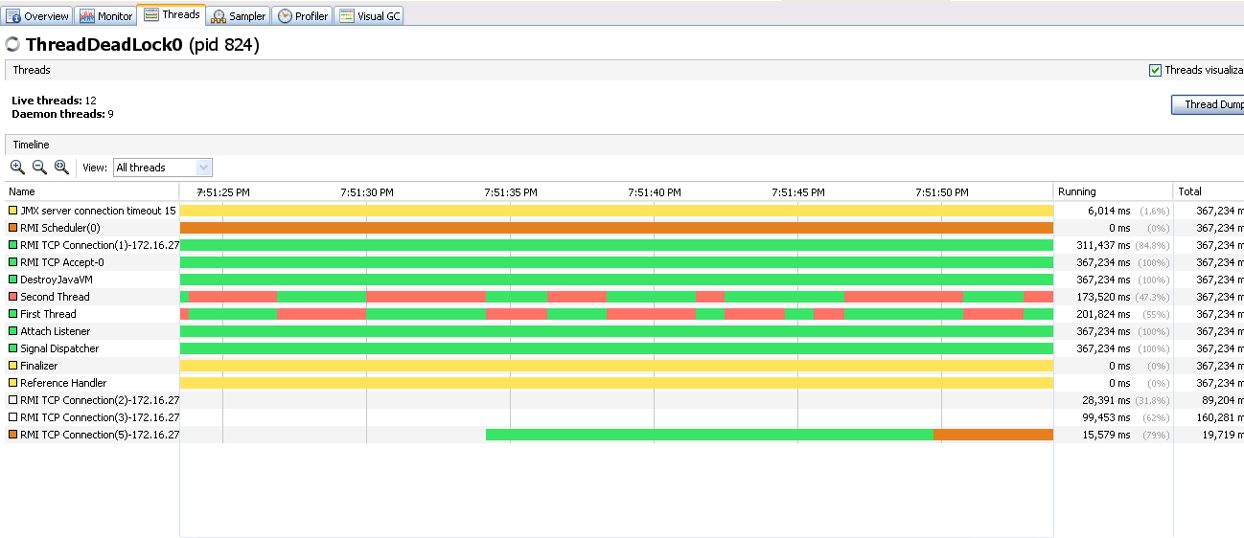
Threads status in VisualVM

Slide 102
When code of static method loads into memory?

Slide 103
Improving lock performance
Below are various approaches which can be applied during code development/design, to improve lock performance.
Lock splitting
Use built in concurrent data structures
Protect data instead of code
Lock scope reduction.

Slide 104
Jstack tool purpose
‘jstack’ is an effective command line tool to capture thread dumps, available with JDK
How to use?
jstack -l <pid> > <file-path>
pid: is the Process Id of the application, whose thread dump should be captured
file-path: is the file path where thread dump will be written in to.
Example:
jstack -l 37320 > C:/threadDump.txt

Slide 105
Tuning JIT Compiler
Java virtual machines (JVM) use Just-In-Time (JIT) compilers to compile Java byte codes into native instructions during server run time. A JIT compiler is a platform-specific compiler that generates machine instructions for each method as needed. These compilers can affect startup or runtime performance.

Slide 106
What optimizations JIT can perform?
Below are optimizations, which JIT can perform.
Inline methods - instead of calling method on an instance of the object it copies the method to caller code. The hot methods should be located as close to the caller as possible to prevent any overhead.
Eliminate locks if monitor is not reachable from other threads
Replace interface with direct method calls for method implemented only once to eliminate calling of virtual functions overhead
Join adjacent synchronized blocks on the same object
Eliminate dead code
Drop memory write for non-volatile variables
Remove prechecking NullPointerException and IndexOutOfBoundsException

Slide 107
Tuning JIT Compiler
Lets check how we can Monitor and Tune JIT Compiler
Java Launcher Codecache Option
Measuring Codecache Usage
Constraining the Codecache Size
Reducing Compilations
Reducing Compiled Method Sizes
NOTE: How to check all JVM options?
java -XX:+PrintFlagsFinal | more
java -XX:+PrintFlagsFinal | findstr GC

Slide 108
How JIT Can improve performance?
JVM generates native code and stores it in a memory area called the codecache. JIT uses major chunk of codecache, how can we control below.
Constrain the amount of codecache available to the JIT.
Tune the JIT to compile fewer methods.
Tune the JIT to generate less code per method.
All are –XX options, for example,
-XX:InitialCodeCacheSize=32m
InitialCodeCacheSize - Initial code cache size (in bytes)
ReservedCodeCacheSize - Reserved code cache size (in bytes) - maximum code cache size
CodeCacheExpansionSize - Code cache expansion size (in bytes)

Slide 109
JIT-Code Cache Flush Options
ExitOnFullCodeCache - Exit the JVM if the codecache fills
UseCodeCacheFlushing - Attempt to sweep the codecache before shutting off compiler
MinCodeCacheFlushingInterval- Minimum number of seconds between codecache sweeping sessions
CodeCacheMinimumFreeSpace - When less than the specified amount of space remains, stop compiling.

Slide 110
JIT-Compilation Limit Options
MaxInlineLevel - Maximum number of nested calls that are inlined
MaxInlineSize - Maximum bytecode size of a method to be inlined
MinInliningThreshold - Minimum invocation count a method needs to have to be inlined
InlineSynchronizedMethods - Inline synchronized methods

Slide 111
JIT-Diagnostic Options
PrintFlagsFinal - Print all JVM options
PrintCodeCache - Print the code cache memory usage when exiting
PrintCodeCacheOnCompilation - Print the code cache memory usage each time a method is compiled
VERBOSE GARBAGE COLLECTION
Java –verbose:jit <class_name>
Above will display Garbage Collection details on console
NOTE: console output can be redirected to a file by suffixing above java command with >> logfile.txt
where logfile.txt is filename

Slide 112
Diff. b/n synchronized and concurrent collections
Both methods suggest that the Java Virtual Machine expend effort toward recycling unused objects in order to make the memory they currently occupy available for quick reuse. When control returns from the method call, the Java Virtual Machine has made a best effort to reclaim space from all discarded objects.
The System.gc() is a static method so it's a little bit more convenient to use. The call System.gc() is effectively equivalent to the call:
Runtime.getRuntime().gc();

Slide 113
Diff. b/n System.gc() and Runtime.getRuntime.gc()
Both methods suggest that the Java Virtual Machine expend effort toward recycling unused objects in order to make the memory they currently occupy available for quick reuse. When control returns from the method call, the Java Virtual Machine has made a best effort to reclaim space from all discarded objects.
The System.gc() is a static method so it's a little bit more convenient to use. The call System.gc() is effectively equivalent to the call:
Runtime.getRuntime().gc();

Slide 114
Diff. b/n Client and Server JVM
To choose between server and client mode we can have client mode for small programs that are not executed for a longer period and server mode otherwise. The startup of the JVM might be slower in server mode and the runtime memory footprint also will be larger. Client mode starts JVM in quicker time and memory footprint is also lesser. This is because client mode does not try to optimize many code blocks as the server mode does. Therefore the shorter startup time and less memory usage.
So what is the special optimization done by server mode? One example is in lining of virtual method invocations wherever it is used. This is done by adaptive compilation. One more thing done by server mode is, it does not give back the memory acquired back to the OS till the execution is complete. But in case of client mode if a certain block of memory is left unused it may give back to the OS during the execution of the program. Initial options like InitialHeapSize and MaxHeapSize are taken as large numbers in server mode on launch in comparison with client mode.

Slide 115
HotSpot JVM and other Flavours

Slide 116
HotSpot JVM and other Flavours
By Default JVM is launched in client mode, when java command is invoked.
Launch JVM in Server mode, as below.
java -server ClassName
They are essentially two different compilers (JITs) interfacing to the same runtime system. The client system is optimal for applications which need fast startup times or small footprints, the server system is optimal for applications where the overall performance is most important. In general the client system is better suited for interactive applications such as GUIs

Slide 117
Purpose of jstatd?

Slide 118
Miscellaneous
-XX:+HeapDumpOnOutOfMemoryError writes heap dump on OutOfMemoryError (recommended)
-XX:+HeapDumpOnCtrlBreak writes heap dump together with thread dump on CTRL+BREAK
-Xmn[size]: Size of young generation heap space.
Applications with emphasis on performance tend to use -Xmn to size the young generation, because it combines the use of -XX:MaxNewSize and -XX:NewSize and almost always explicitly sets -XX:PermSize and
-XX:MaxPermSize to the same value.
Heap Size can be specified in GB, just by suffixing with g
Log4j supports Asynchronous Logging
https://logging.apache.org/log4j/log4j-2.3/manual/async.html
AWS(Amazon Web Services) supports Heap and GC Tuning on the instances

Slide 119
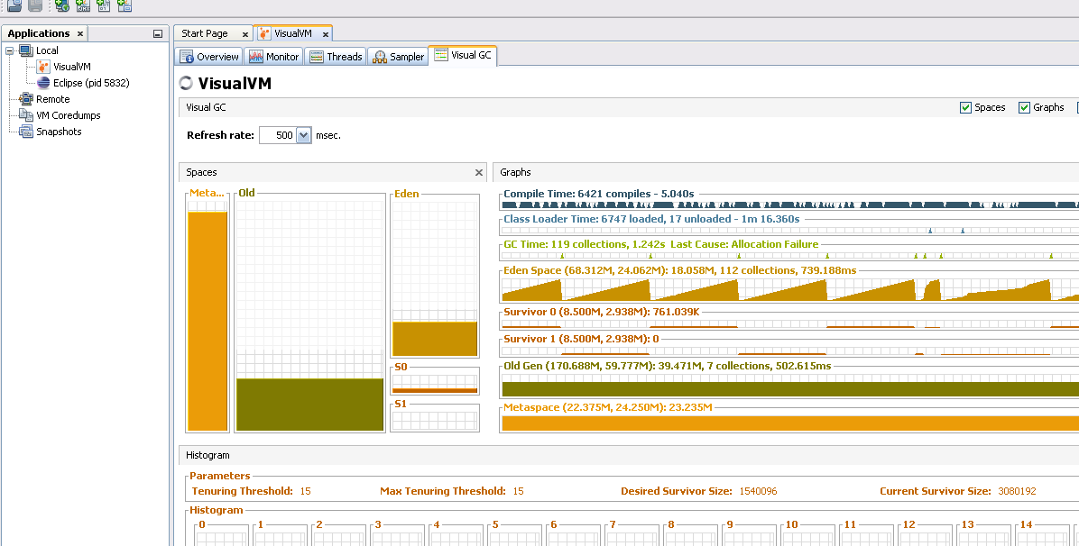
VisualVM
Memory reclaimed thru GC run
No. of GC runs
Maximum Capacity
Current Capacity
Total time GC has run

Slide 120
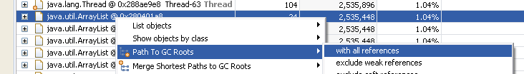
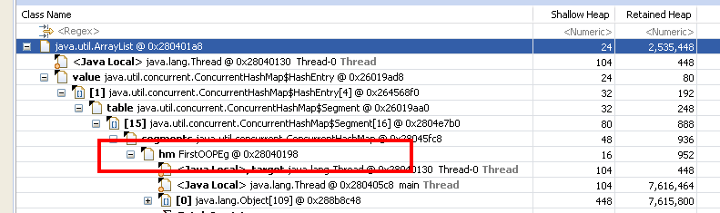
How to find our code, which may have memory leaks
How to find where Memory Allocation has been done from our code, using Eclipse MAT Tool?
#1. Select Dominator Tree, from Top Menu of MAT Tool.
#2. Now you will get list of classes, which are Memory leaks suspected.
#3. Sort based on Retained Heap Size, by clicking on Retained Heap Size.
#4. Now right click on any class, and select “Path To GC Roots”, and then select “with all references”.
#5. Select each Class, in the Path, until you find your Class

Slide 121
How to find our code, which may have memory leaks
In Previous slide, please check that your class hm.FirstOOPEg creates ConcurrentHashMap object some where, which might be root cause of memory Leak
Now try to review the code, make necessary code changes to remove memory Leak, and check other Memory Leaks repeating steps 4 and 5 in previous slide.
After code changes, get the Heapdump, and analyse the dump, to check whether Memory Leaks have been removed.

Slide 122
How to analyze jvm on a remote machine?
There are two ways
Approach A
Generate Heapdump directly on RemoteMachine. Heapdump may be even few GBs in size, and it may even take 30 mins or even hours to generate Heap. It depends on HeapSize on the Server. This might slowdown your server, ensure that your production server normal operations does not get slowed down due to this.
Download Heapdump file to your Local Desktop System, to Analyze it.
Analyze the Heapdump using MAT or any other tool.
Approach B
Connect directly to remote Server machine

Slide 123
ApproachB: How to connect visualvm to a remote jvm
Step1:
To connect to a remote VM you have to start that remote VM with specific options:
java -Dcom.sun.management.jmxremote -Dcom.sun.management.jmxremote.port=9000 -Dcom.sun.management.jmxremote.ssl=false -Dcom.sun.management.jmxremote.authenticate=false class _name
Step2:
After the VM is started, go to your VisualVM and do the following:
File -> Add JMX Connection
Type: yourHostName:9000 and click OK
On the left you will have the added JMX connection, double click on it, to start monitoring remote JVM
NOTE: 1.If still not working please check if Firewall is blocking port 9000
2. If you want to simulate remote connection using single system. Try running Java program using above Step1, after which try connecting from jconsole/visualvm, by providing 127.0.0.1:9000 where 9000 is port number

Slide 124
How to connect to remote jvm
How to connect to Remote WebLogic Server
Update the setDomainEnv.cmd with the below parameters in the JAVA_OPTIONS and restart the Weblogic Server
For non- authenticated user and non – ssl mechanism:
-Dcom.sun.management.jmxremote
-Dcom.sun.management.jmxremote.port=9001
-Dcom.sun.management.jmxremote.ssl=false
-Dcom.sun.management.jmxremote.authenticate=false
For authenticated SSL mechanism:
-Dcom.sun.management.jmxremote.ssl=true
-Dcom.sun.management.jmxremote.password.file=jmxremote.password
-Djavax.net.ssl.keyStore=/home/user/.keystore
-Djavax.net.ssl.keyStorePassword=myKeyStorePassword
-Dcom.sun.management.jmxremote.ssl.need.client.auth=true
-Djavax.net.ssl.trustStore=/home/user/.truststore
-Djavax.net.ssl.trustStorePassword=myTrustStorePassword
-Dcom.sun.management.jmxremote.registry.ssl=true
2. start JConsole
jconsole host-name:9001

Slide 125
WeakHashMap
The key of a WeakHashMap has weak reference.
If the key has been garbage collected, then the entry in WeakHashMap object will automatically be deleted.
It does not happen in normal HashMap. The entry will not be deleted if the key is garbage collected.
So, to build a simple Cache, it is preferable to use WeakHashMap, reason is whenever Garbage Collector runs, the entries get removed
However, WeakHashMap, is not synchronized, by default

Slide 126
Profiler
JDK comes with a built-in profiler to help identify where time is spent in a program.
It will keep track of the time spent in each routine and write the information to the file java.prof.
To run the profiler, use the -prof option when invoking the Java interpreter:
java –prof ExampleProgram

Slide 127
Apache Tomcat
Apache Tomcat can run on any JVM of your Wish.
How to change JVM used by Apache Tomcat?
Simply edit catalina.sh, found in Tomcat's bin folder, and change the JAVA_HOME environment variable to the directory of your chosen JVM's JDK. When you restart Tomcat, it will be running on your new JVM.
Effective Memory Management
The main thing to consider when tuning your JVM for Tomcat performance is how to avoid wasting memory and draining your server's power to process requests. Certain automatic JVM processes, such as garbage collection and memory reallocation, can chew through memory if they occur more frequently than necessary. You can make sure these processes only occur when they need to by using the JAVA_OPTS -Xmx and -Xms switches to control how JVM handles its heap memory.
If your JVM is invoking garbage collection too frequently, use the -Xmx switch to start the JVM with a higher maximum heap memory. This will free up CPU time for the processes you really care about.
To get even more out of this change, you can include the -Xms switch. This switch makes the JVM's initial heap memory size equal to the maximum allocated memory. This means the JVM will never have to reallocate more memory, a costly process that can eat up power you want being used to serve incoming requests.

Slide 128
Apache Tomcat
# CATALINA_OPTS (Optional) Java runtime options used when the "start",
# "run" or "debug" command is executed.
# Include here and not in JAVA_OPTS all options, that should
# only be used by Tomcat itself, not by the stop process,
# the version command etc.
# Examples are heap size, GC logging, JMX ports etc.
# JAVA_OPTS (Optional) Java runtime options used when any command # is executed.
# Include here and not in CATALINA_OPTS all options, that
# should be used by Tomcat and also by the stop process,
# the version command etc. # Most options should go into CATALINA_OPTS.

Slide 129
Jboss, where to specify JVM options?
For a standalone sever you have to pass in the JVM settings either as command line arguments when executing the $JBOSS_HOME/bin/standalone.sh script,
or by declaring them in $JBOSS_HOME/bin/standalone.conf.
For Windows users, the script to execute is %JBOSS_HOME%/bin/standalone.bat while the JVM settings can be declared in %JBOSS_HOME%/bin/standalone.conf.bat.
Add a line to standalone.conf
if [ -n "$MY_OPTS" ]; then
JAVA_OPTS="$JAVA_OPTS $MY_OPTS"
fi
This append your options to the defaults, a command line, when invoked as below:
standalone.sh MY_OPTS="-Xmx1024m"

Slide 130
Web Logic performance tuning
It can be categorized in 4 parts. a. Application Tuning. jsp precompilation, ejb pool size cache..
b. OS Tuning
Setting tcp ip parameter. tcp_time_wait_interval tcp_conn_req_max_q
c. Core Server Tuning.
tune workmanager, tune chuck size and chunck pool size, using performance packs, connection backlog buffering.
d. JVM Tuning tuning gc strategy, monitoring garbage collection..

Slide 131
weblogic
startWebLogic.cmd /.sh

Slide 132
Jdbc Performance Improvement
1. Using batch operations.
You can read your big query and store results in some kind of buffer. And only when buffer is full you should run subquery for all data collected in buffer. This significantly reduces number of SQL statements to execute.
static final int BATCH_SIZE = 1000; List<MyData> buffer = new ArrayList<>(BATCH_SIZE); while (rs.hasNext()) { MyData record = new MyData( rs.getString(1), ..., rs.getString(4) ); buffer.add( record ); if (buffer.size() == BATCH_SIZE) { processBatch( buffer ); } } void processBatch( List<MyData> buffer ) { String sql = "select ... where X and id in (" + getIDs(buffer) + ")"; stat1.executeQuery(sql); // query for all IDs in buffer while(stat1.hasNext()) { ... } ... }
2. Using efficient maps to store content from many selects.
If your records are no so big you can store them all at once event for 4 mln table.
I used this approach many times for night processes (with no normal users). Such approach may need much heap memory (i.e. 100 MB - 1 GB) - but is much faster that approach 1).
To do that you need efficient map implementation, i.e. - gnu.trove.map.TIntObjectMap (etc) which is much better that java standard library maps.
final TIntObjectMap<MyData> map = new TIntObjectHashMap<MyData>(10000, 0.8f); // query 1 while (rs.hasNext()) { MyData record = new MyData( rs.getInt(1), rs.getString(2), ..., rs.getString(4) ); map.put(record.getId(), record); } // query 2 while (rs.hasNext()) { int id = rs.getInt(1); // my data id String x = rs.getString(...); int y = rs.getInt(...); MyData record = map.get(id); record.add( new MyDetail(x,y) ); } // query 3 // same pattern as query 2 After this you have map filled with all data collected. Probably with a lot of memory allocated. This is why you can use that method only if you hava such resources.
Another topic is how to write MyData and MyDetail classes to be as small as possible. You can use some tricks:
storing 3 integers (with limited range) in 1 long variable (using util for bit shifting)
storing Date objects as integer (yymmdd)
calling str.intern() for each string fetched from DB

Slide 133
Jdbc Performance Improvement…
3. Transactions
If you have to do some updates or inserts than 4 mln records is too much to handle in on transactions. This is too much for most database configurations. Use approach 1) and commit transaction for each batch. On each new inserted record you can have something like RUN_ID and if everything went well you can mark this RUN_ID as successful.
If your queries only read - there is no problem. However you can mark transaction as Read-only to help your database.
4. Jdbc fetch size.
When you load a lot of records from database it is very, very important to set proper fetch size on your jdbc connection. This reduces number of physical hits to database socket and speeds your process.
Example:
// jdbc statement.setFetchSize(500); // spring JdbcTemplate jdbc = new JdbcTemplate(datasource); jdbc.setFetchSize(500);Here you can find some benchmarks and patterns for using fetch size:
5. PreparedStatement
Use PreparedStatement rather than Statement.
6. Number of sql statements.
Always try to minimize number of sql statements you send to database.
send to database.

Slide 134
Jdbc Performance Improvement…
7. Avoid retrieving unnecessary columns: don't use "SELECT *".
8. Use connection pooling:
Creating a network connection to a database server is (relatively) expensive. Likewise asking the server to prepare a SQL statement is (relatively) expensive.
Using a connection/statement pool, you can reuse existing connections/prepared statements, avoiding the cost of initiating a connection, parsing SQL etc.
https://www.infoq.com/articles/Diagnosing-Common-Java-Database-Performance-Hotspots
Good Read on Code Optimization:
http://www.ijcaonline.org/research/volume125/number15/gotarane-2015-ijca-906029.pdf

Slide 135
Logging Performance Improvements
Performance is critical for enterprise applications and nobody wants the underlying logging framework to become a bottleneck.
For increased logging performance, we want lower logging latency and higher throughput.
The asynchronous logger in Log4J 2 does this by decoupling the logging overhead from the thread executing your code.
An async logger has consistently lower latency than a synchronous logger and high throughput of logging messages at 6 – 68 times the rate of a synchronous logger.
I/O operations are notorious performance killers. This is because of locks and waits which are typical when dealing with I/O operations.

Slide 136
Performance Tuning Platform Dependency
Performance Tuning done for your desktop/laptop, cannot be applied to your Web or App Servers
Reason is it depends on underlying Hardware(RAM, CPU, etc…) and Software Platform
Also Tuning may be different from one Web Server to another
Other Performance Guidelines
Use right Collection, in your coding
Avoid Huge objects
Perform profiling of your code from initial phases of project
If you are using any third party libraries/frameworks, there is a chance that they are causing Memory or Performance overheads
Avoid monolithic Huge Software Applications
Scale Horizontally rather than vertically

Slide 137
What is JMX?
Java Management Extensions (JMX) was introduced in J2SE 5.0 release.
It provides an architecture to manage resources dynamically at runtime.
JMX is used mostly in enterprise applications to make the system configurable or to get the state of application at any point of time.
To manage any resource through JMX, we need to create Managed Beans (MBeans) and then register it to the MBean Server.
MBean server works as a management agent for all the MBeans registered.
We use JMX Connectors to connect to MBean server and to manage the registered resources. For example, JDK comes with JConsole through which you can connect to any local or remote MBean server.

